Slide 1
Are progeny phenotypes intermediate between parent phenotypes, more similar to one parent, or do they show transgressive segregation (above or below both parent values) for each trait? Are progeny sets significantly different to each other?

Slide 2
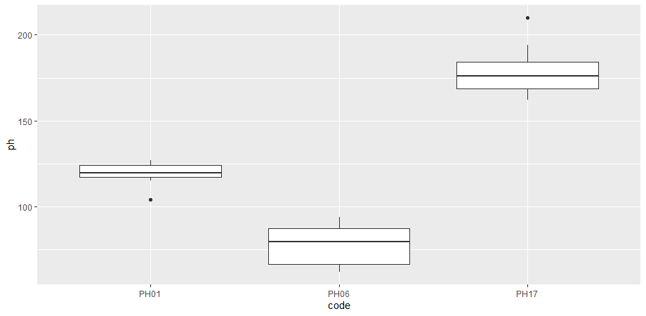
Comparison group 1A: plant height
Plant height (cm?)
B. rapa
B. oleracea
Resynthesised B. napus

Slide 3
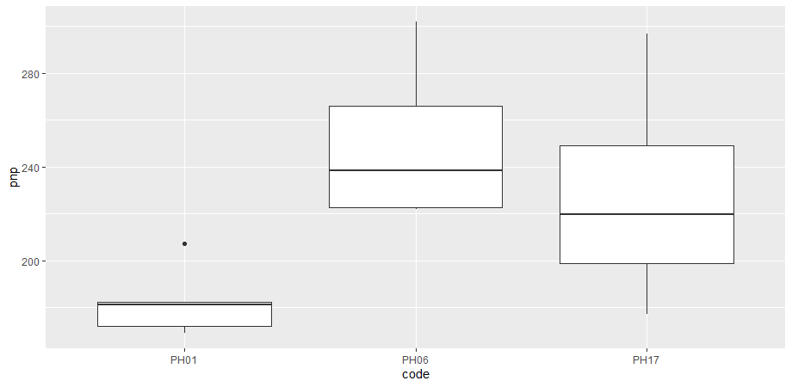
Comparison 1A: pods/plant
Pod number/plant
B. rapa
B. oleracea
Resynthesised B. napus

Slide 4
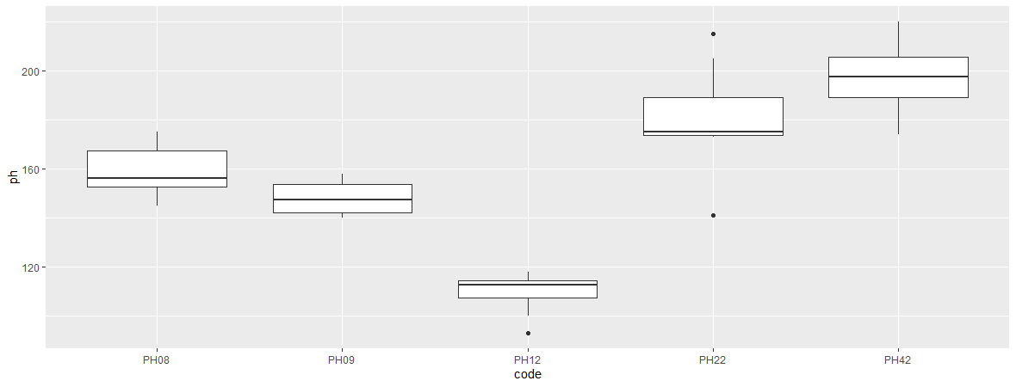
Comparison group 2B: plant height
B. carinata
B. juncea
B. napus
NCJ allohex
NCJ allohex

Slide 5
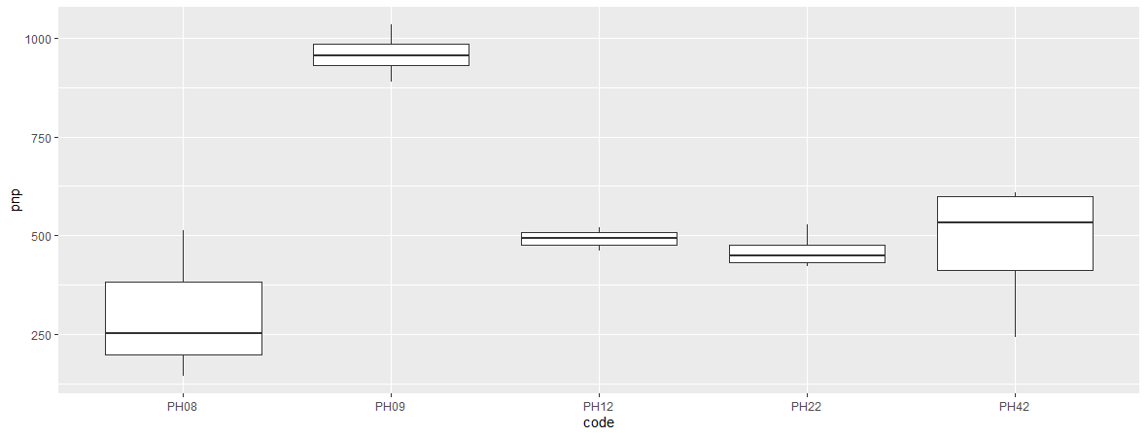
Comparison 2B: pods/plant
B. carinata
B. juncea
B. napus
NCJ allohex
NCJ allohex

Slide 6
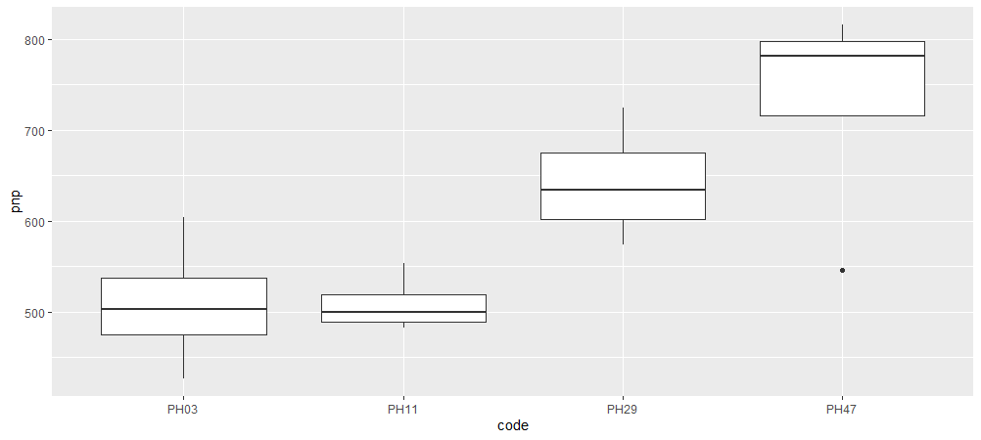
Comparison group 2A: pods/plant
B. oleracea
B. juncea
JO allohex
JO allohex

Slide 7
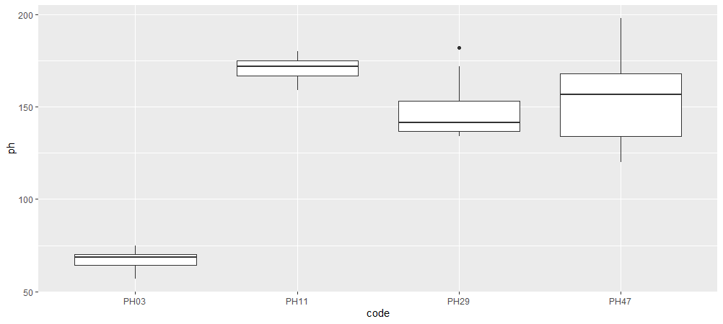
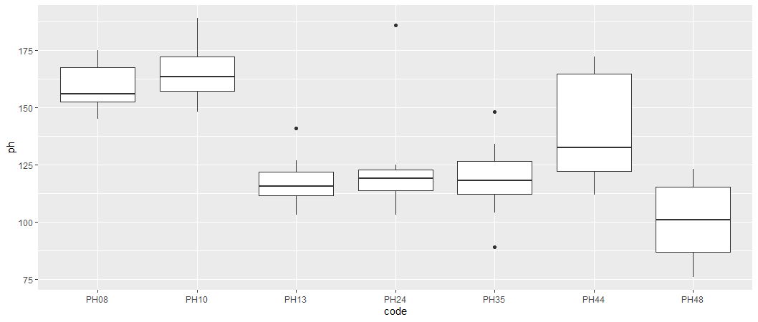
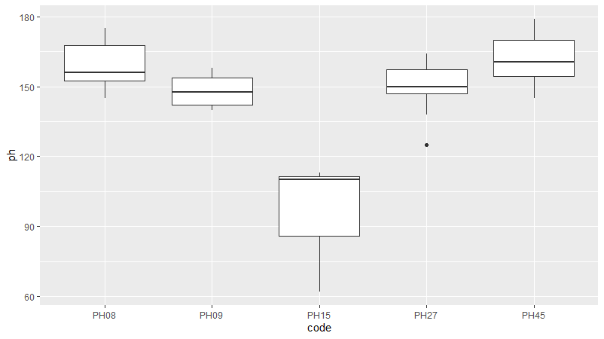

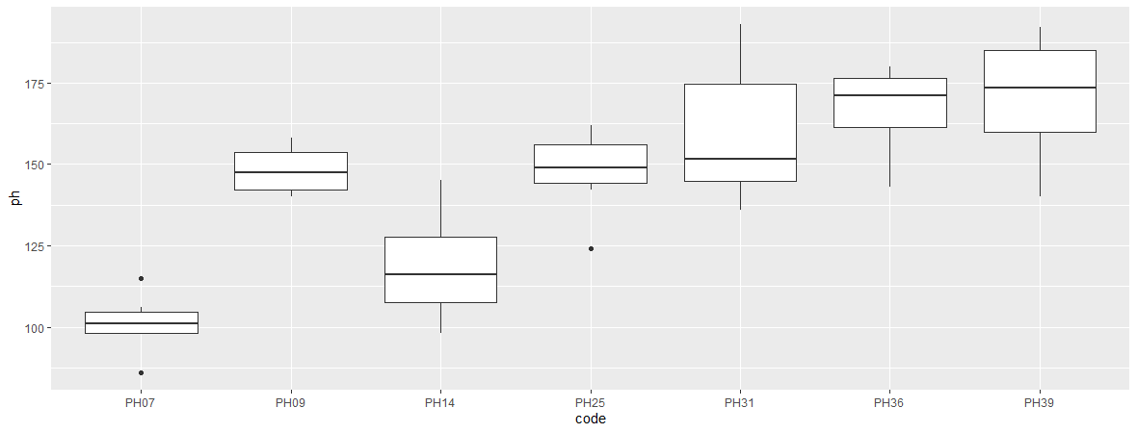
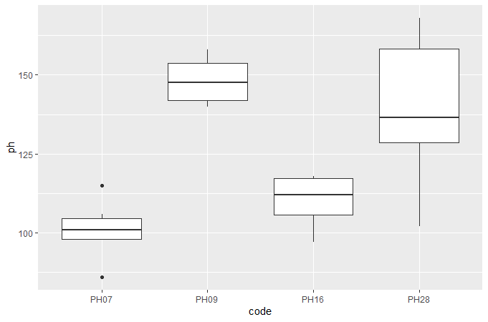
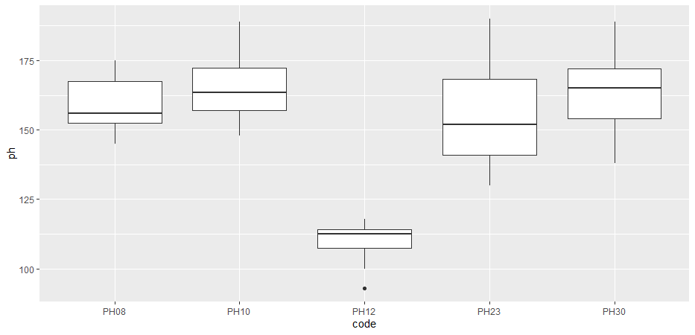
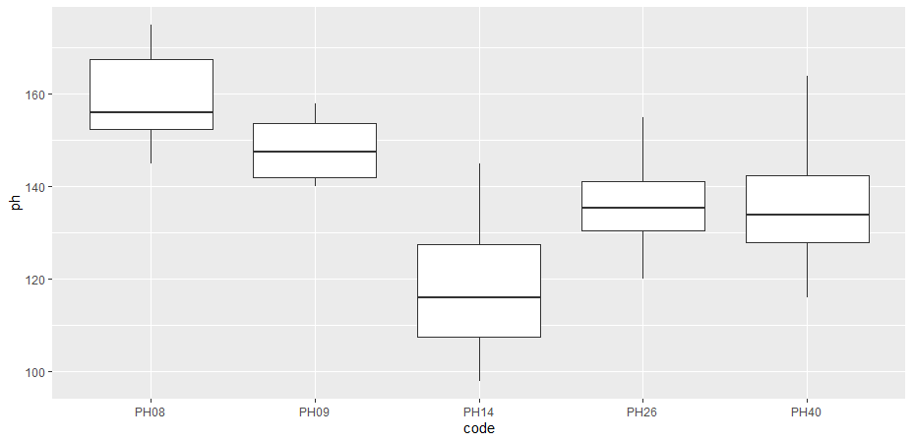
Comparison group 2: plant height

Slide 8

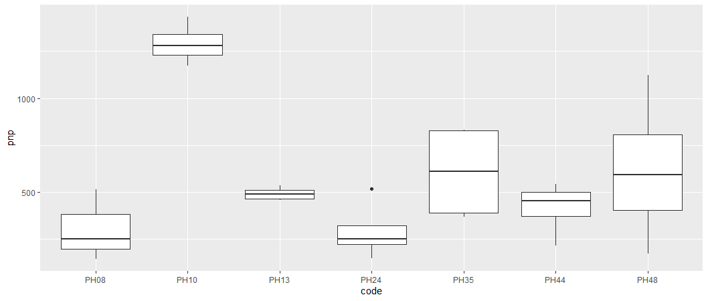
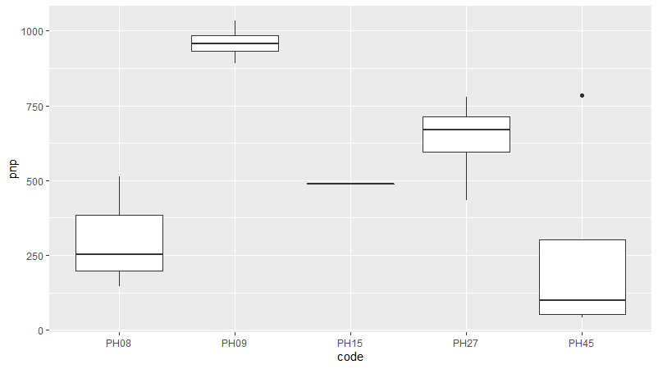

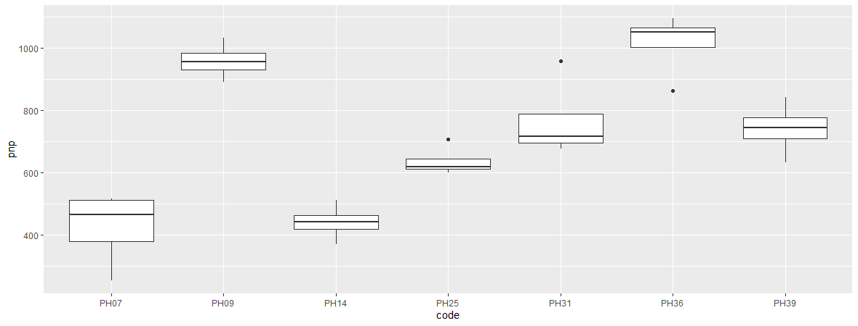
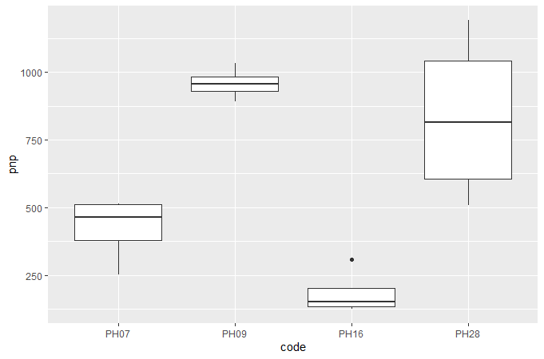
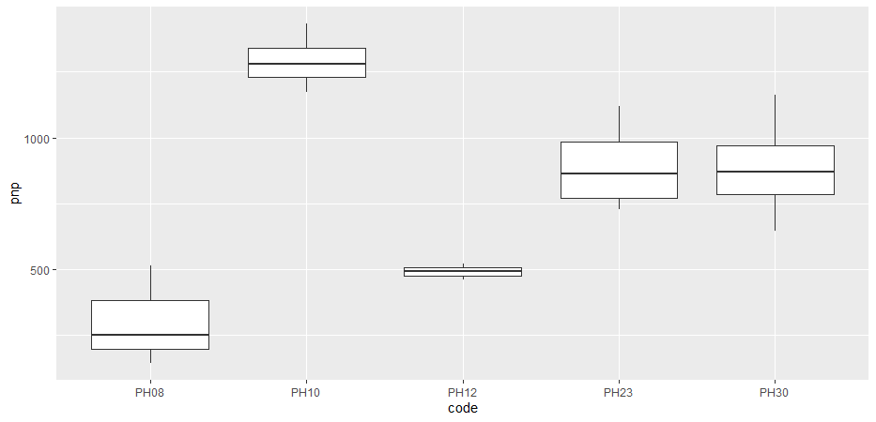
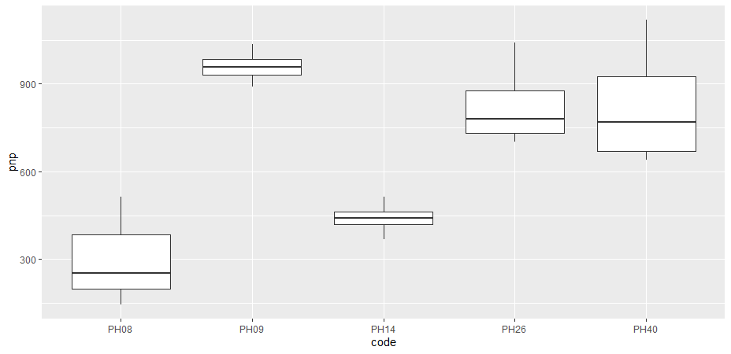
Comparison group 2: number of pods/plant
P a r e n t s
Progeny

